Slide 1
Control Flow
Decision making is required when we want to execute a code only if a certain condition is satisfied.
The if…elif…else statement is used in Python for decision making.
if x expression:
statement(s)
Start
Test
False
True
Body of If

Slide 2
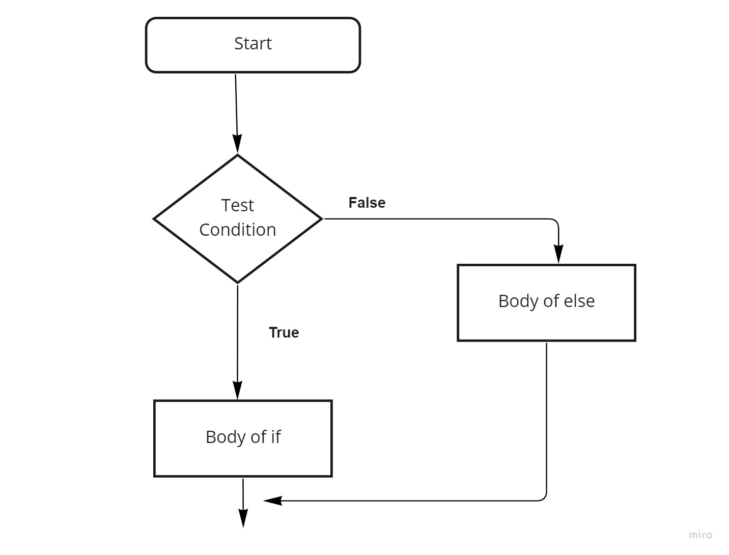
Python if...else Statement

Slide 3
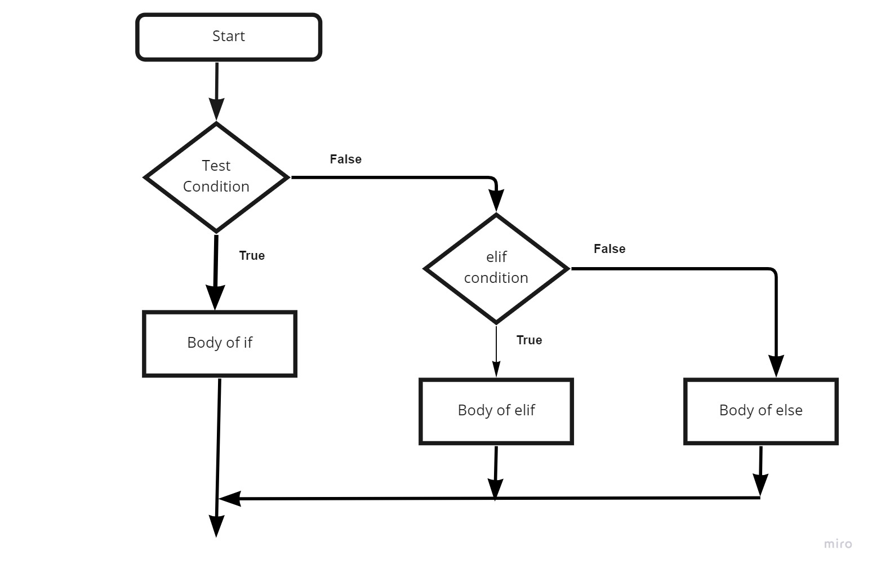
Flowchart of if...elif...else

Slide 4
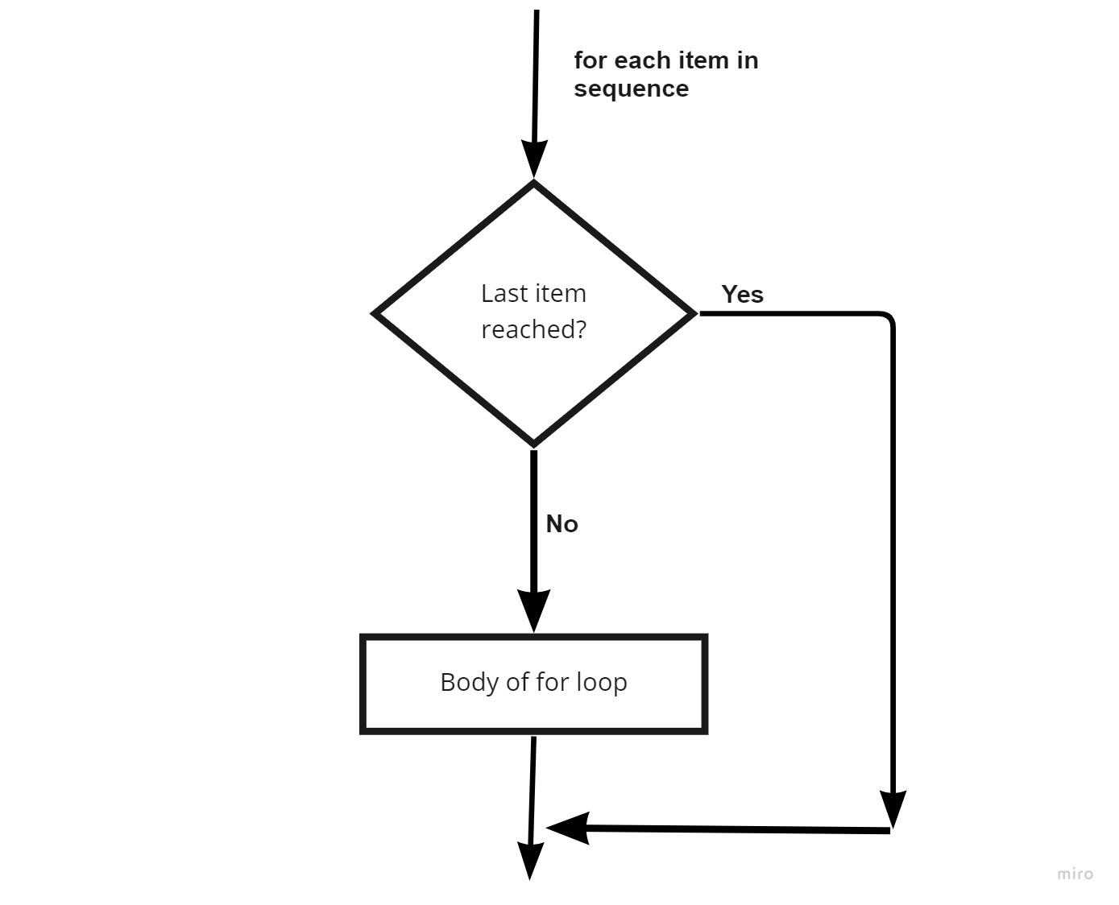
For Loop
The for loop in Python is used to iterate over a sequence

Slide 5
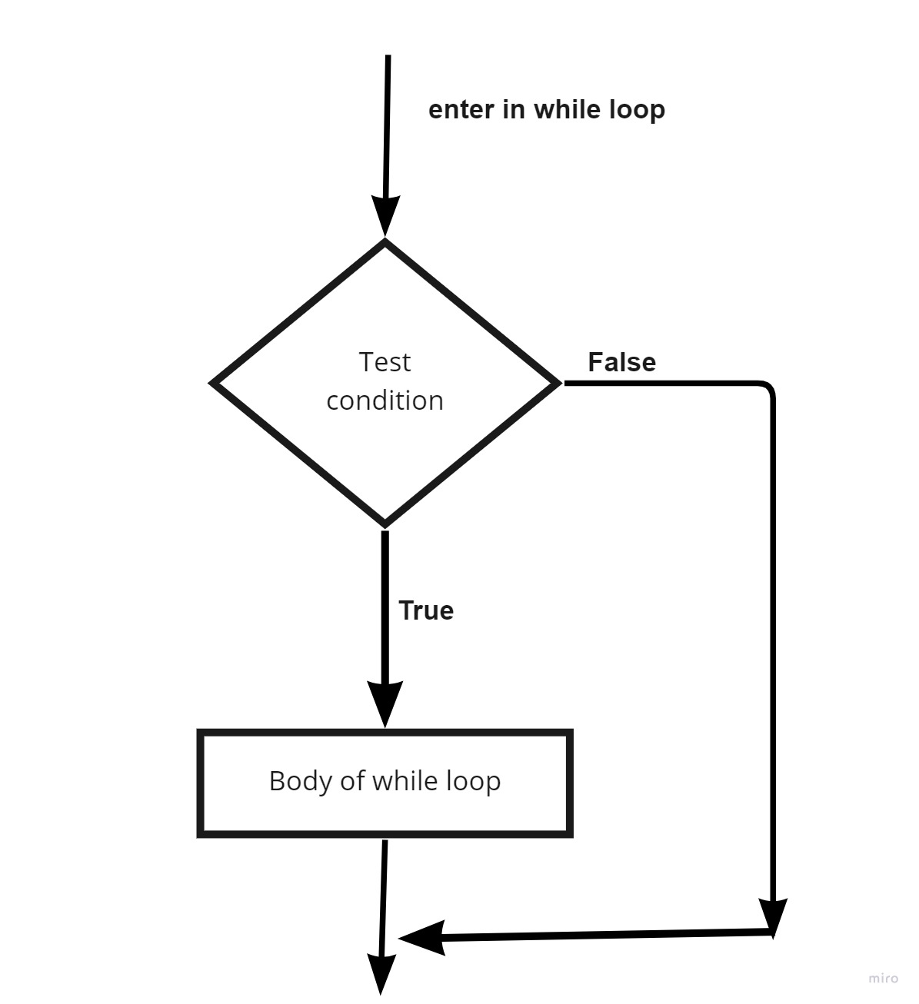
While Loop
The while loop in Python is used to iterate over a block of code as long as the test expression (condition) is true

Slide 6
Jupyter Notebook https://jupyter.org/install

